Slide 1
Easy MDF Door Maker

Slide 2
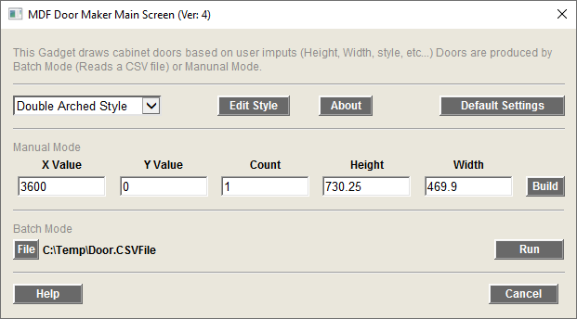
Main Screen
Edit Selected Door Style
About Gadget
Edit Defaults Setting
Select Door Style
Draw Door (s) based on the setting shown here
Set the X value for Draw Door
CSF File To Read
Run the Batch Mode Process
Set the Y value for Draw Door
Set the number of Doors drawn

Slide 3
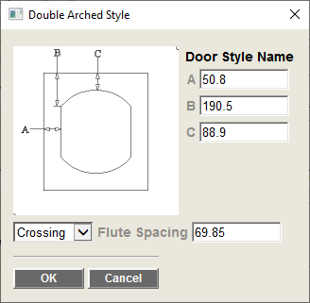
Style Edit Screen
Enter Values for the Items listed in the image

Slide 4
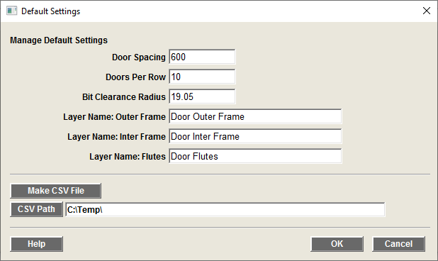
Defaults Screen
Distance Between Doors (See drawing)
Number of Doors per Row in the drawing
Layer Names
Inter profile Bit Clearance
Makes a Seed CSV File (based on current drawing Units)
Select where to make the Seed CSV File

Slide 5
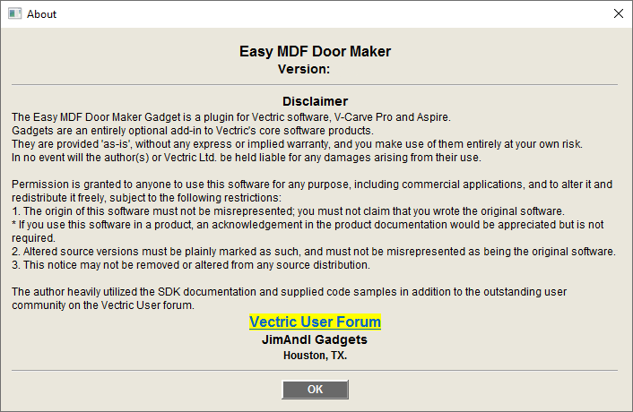
About Screen

Slide 6
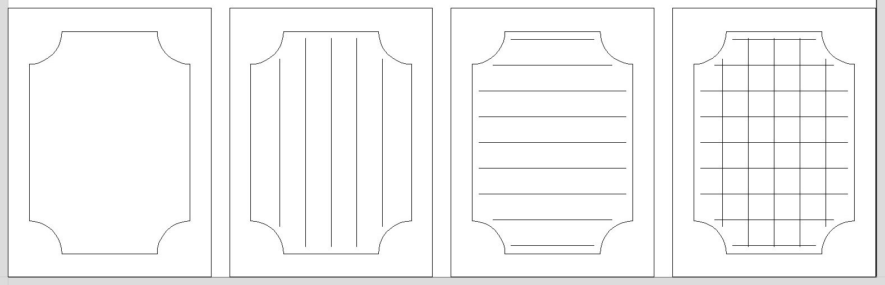
Fluting Options
Options:
None
Vertical
Horizontal
Crossing

Slide 7
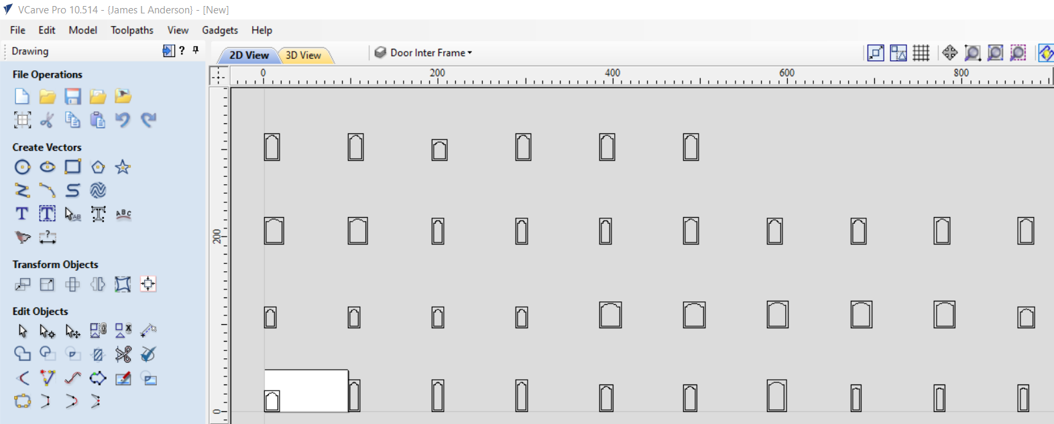
Drawing of Doors
Distance Between Door Value

Slide 8
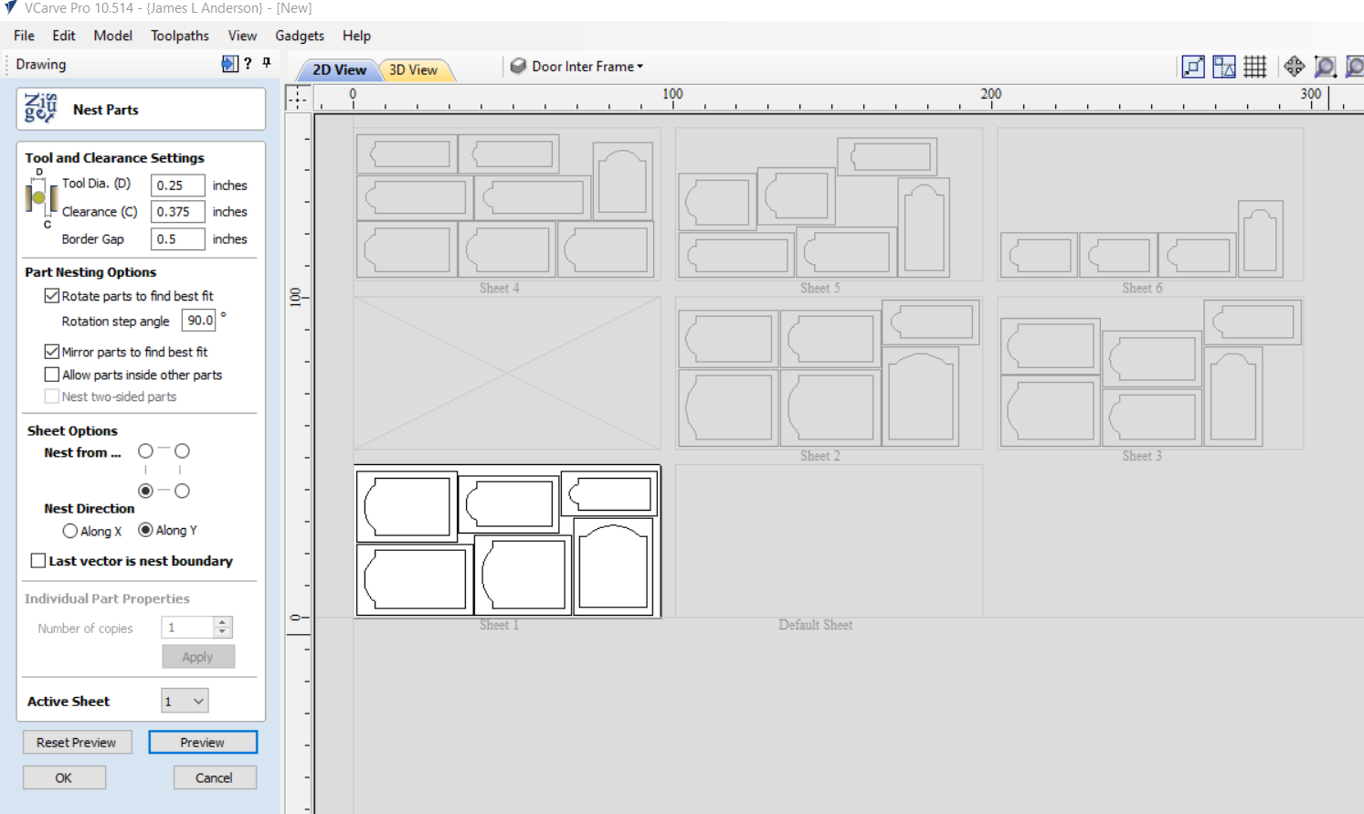
Using the Nesting Tool

Slide 9
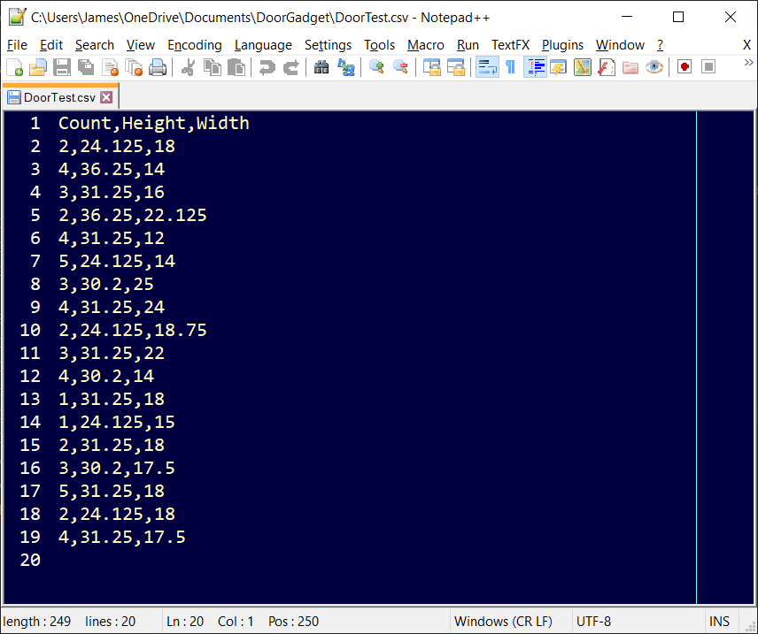
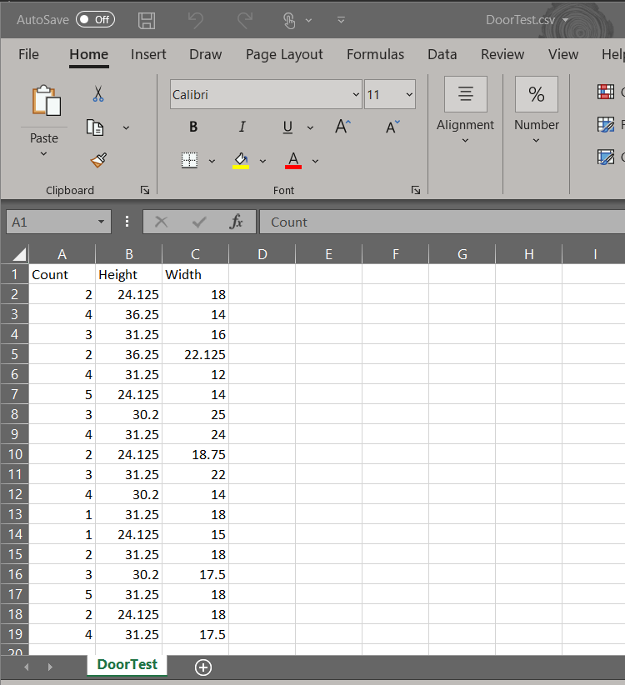
Edit CSV file in Excel or Text editor

Slide 10
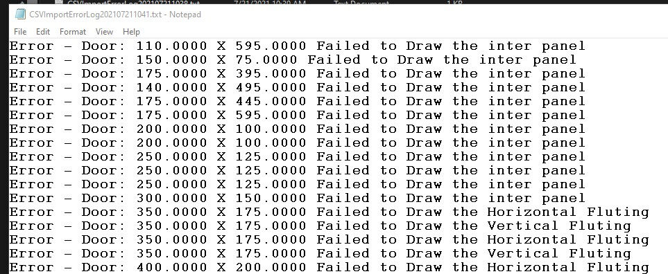
Error Log Report

